Slide 1
Microcontroller Design
Logan Mayhew, Danny Murray, Roy Helms, John Humphries, Sren Heng

Slide 2
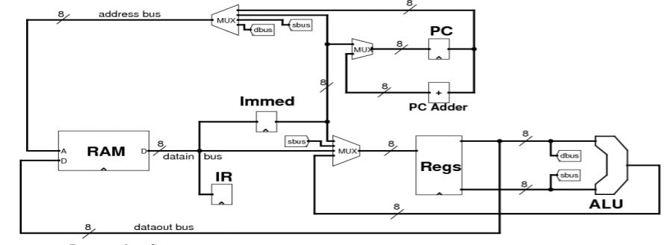
Architecture

Slide 3
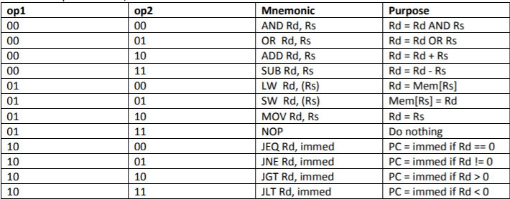
Instruction Set

Slide 4
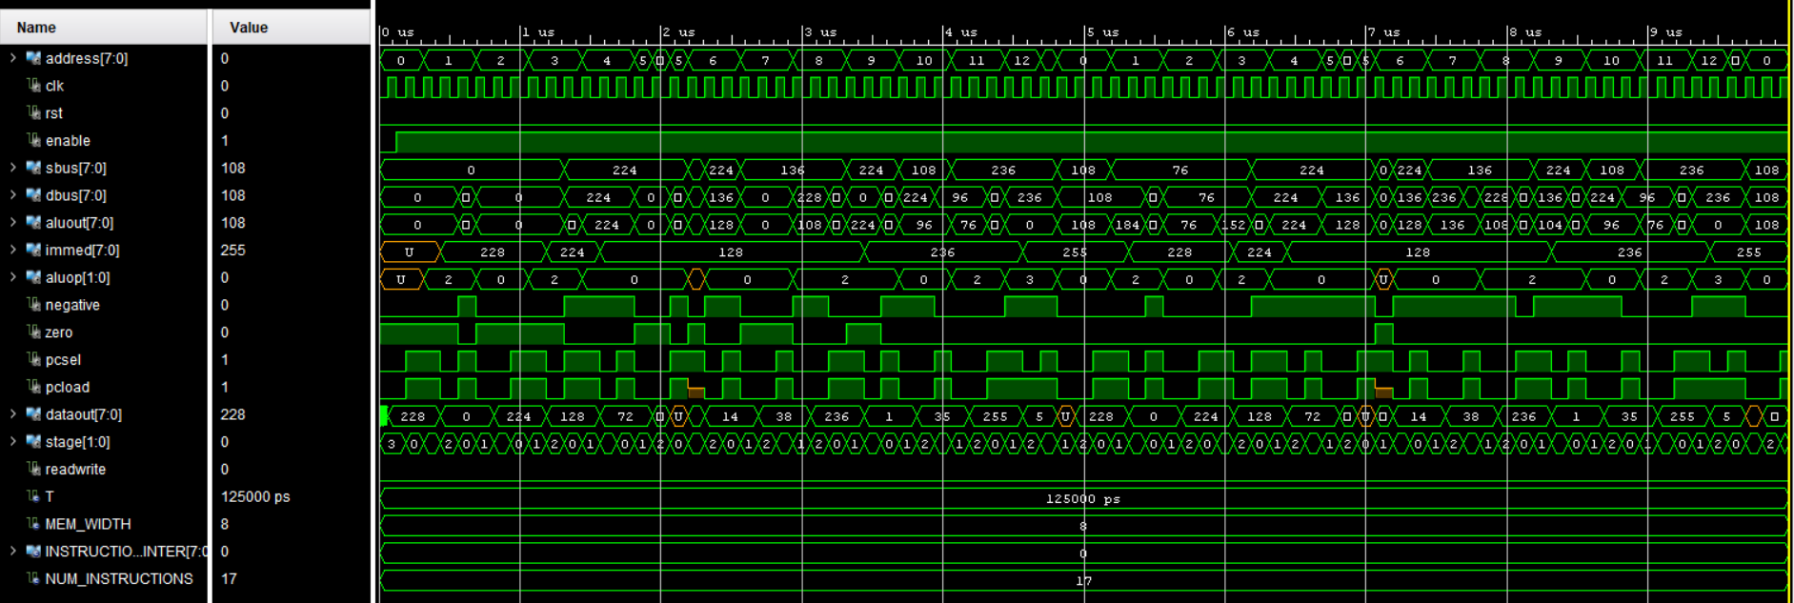
Final Waveform with ImLoad Error

Slide 5
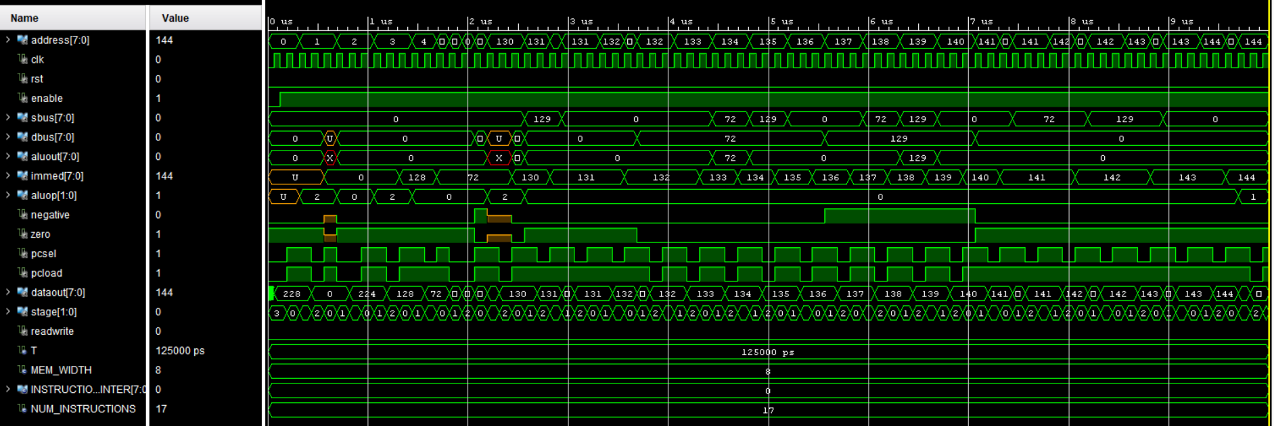
Final Waveform with ImLoad Desync Error

Slide 6
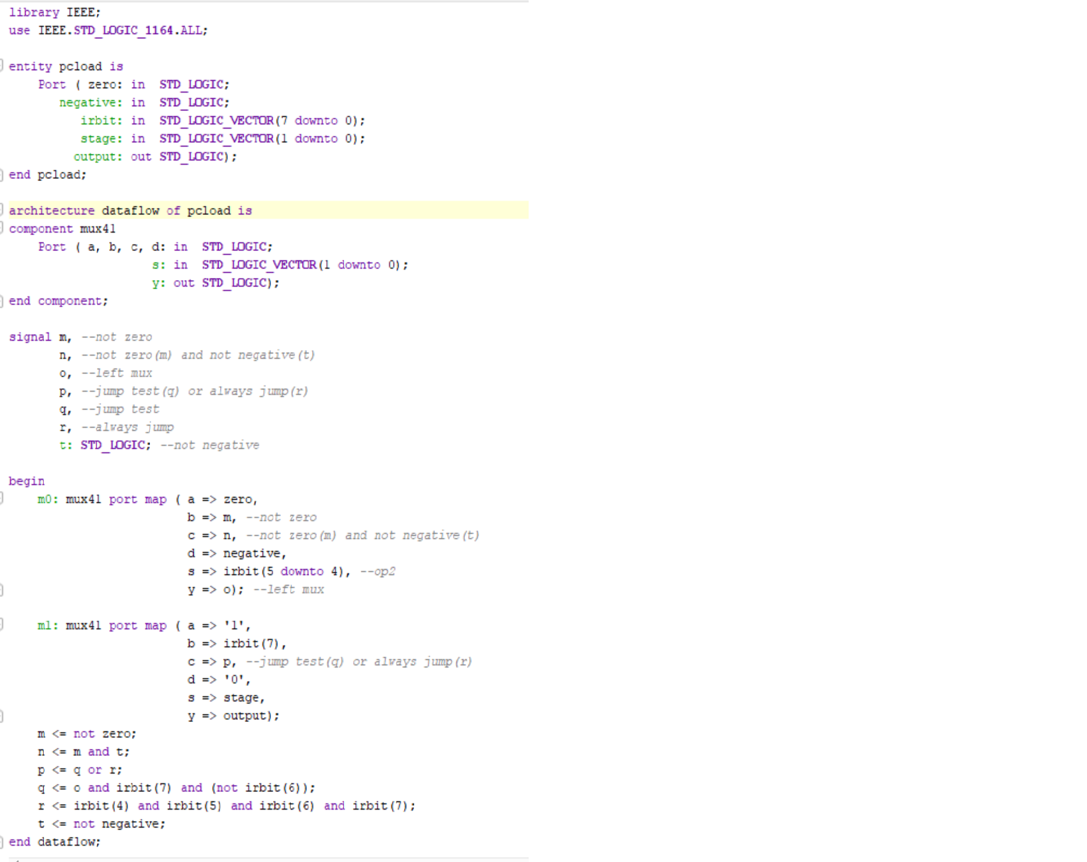
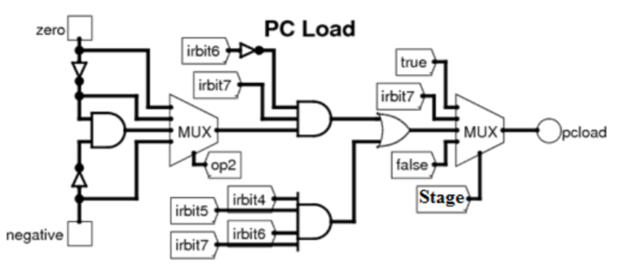
PC Load

Slide 7
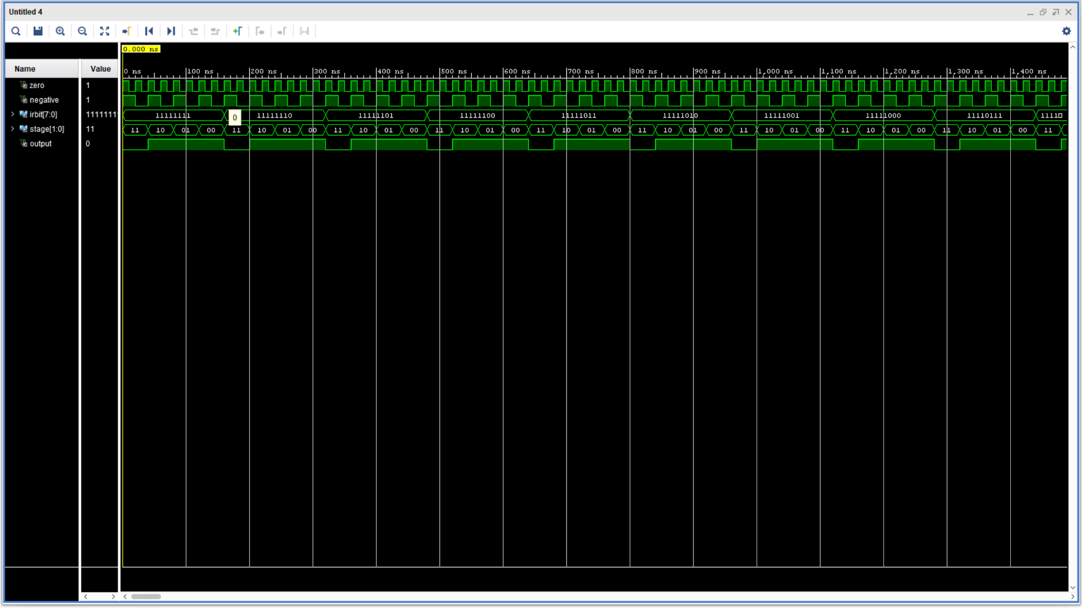
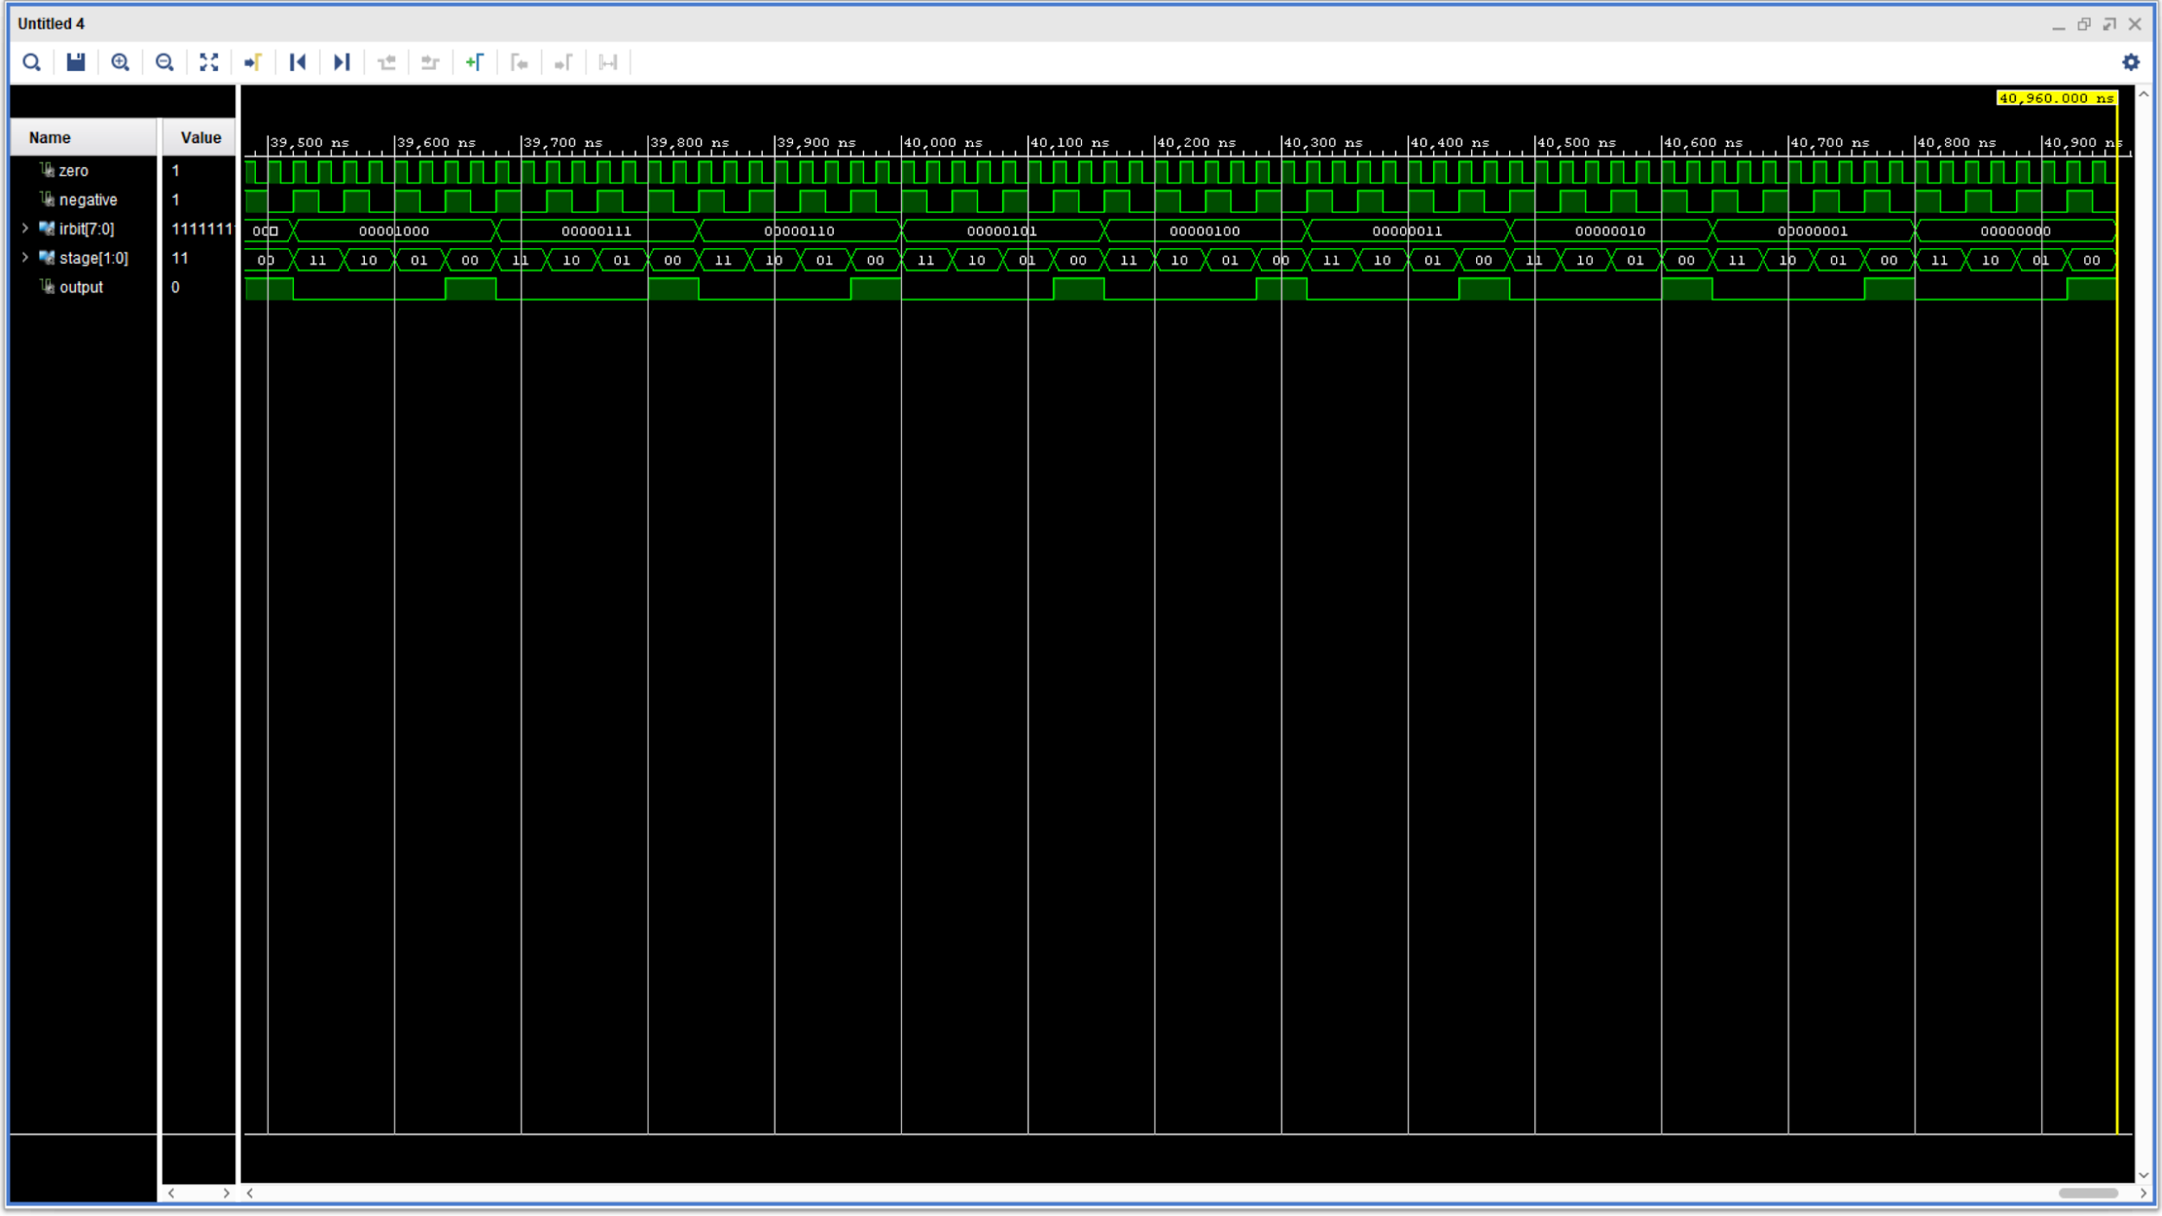
PC Load Simulation

Slide 8
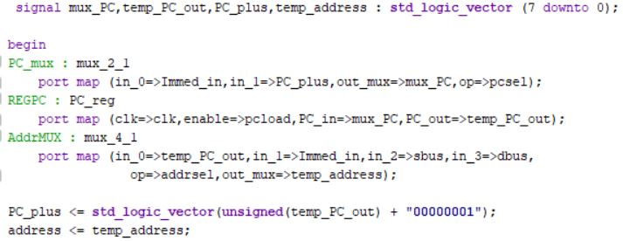
Program Counter

Slide 9
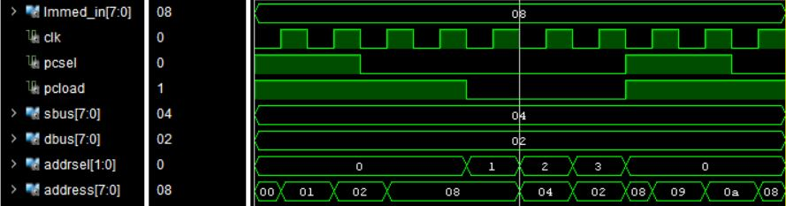
PC Simulation

Slide 10
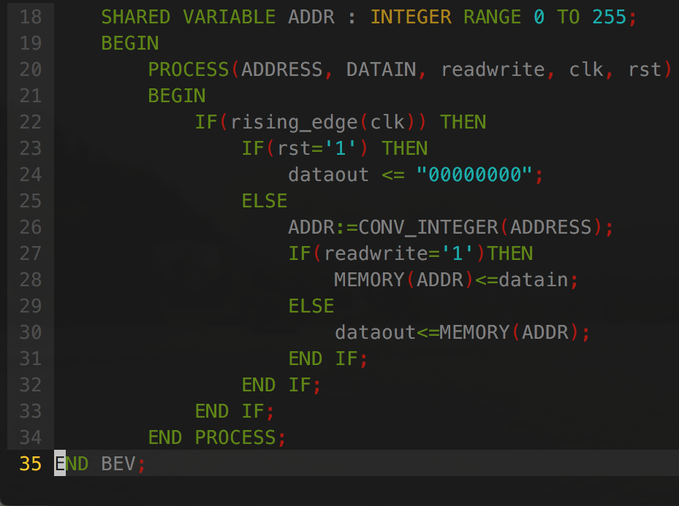
Memory
Synchronous
Reset nullifies dataout
Set readwrite to high to write to memory

Slide 11
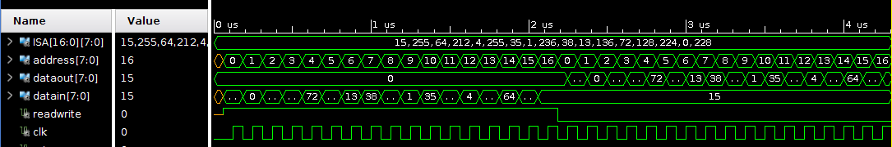
Memory Waveform

Slide 12
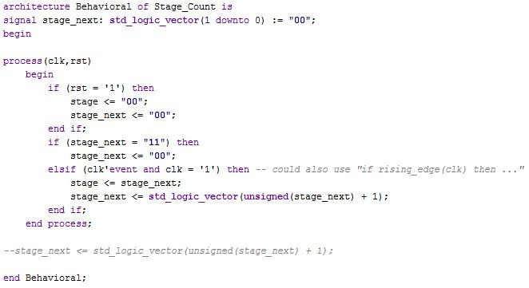
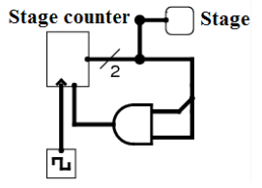
Stage Counter Code

Slide 13
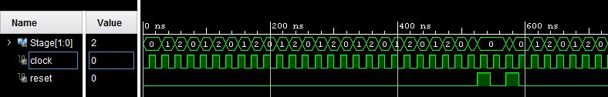
Stage Counter Simulation

Slide 14
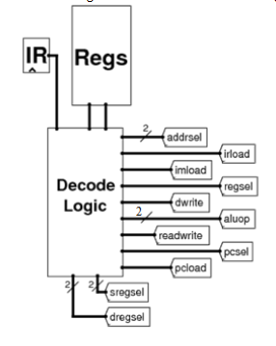
Decode Logic

Slide 15
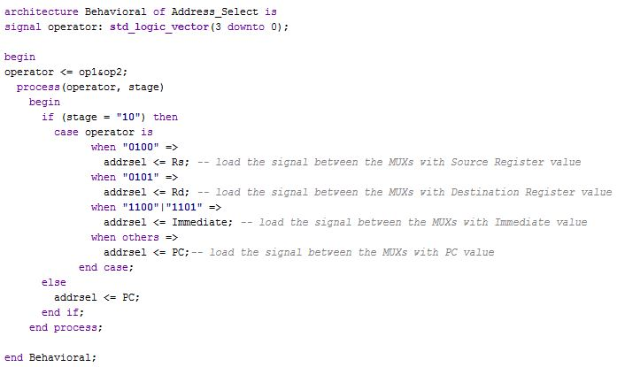
Decode Logic: Address Select Program

Slide 16
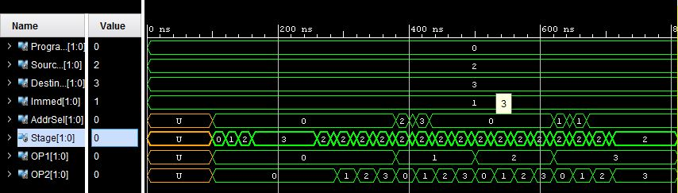
Decode Logic: Address Select Simulation

Slide 17
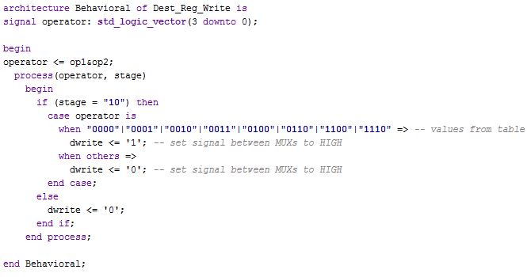
Decode Logic: Dest_Reg_Write Code

Slide 18
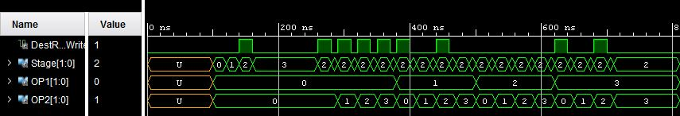
Decode Logic: Dest_Reg_Write Simulation

Slide 19
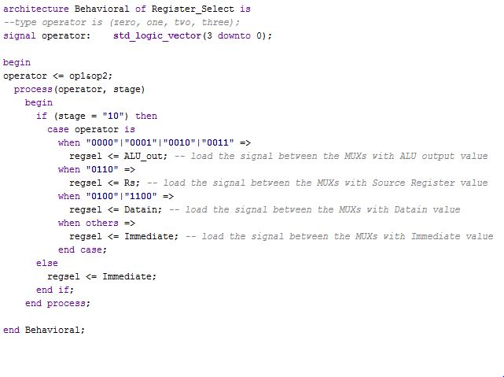
Decode Logic: Dest_Reg_Write Code

Slide 20
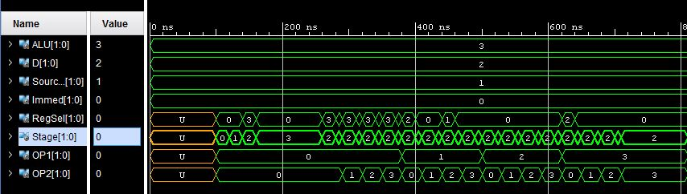
Decode Logic: Register Select Simulation

Slide 21
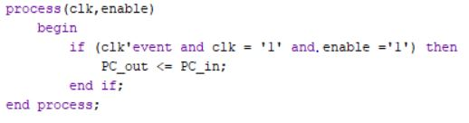
Registers

Slide 22
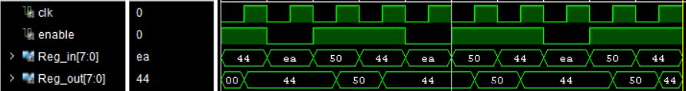
Register Simulation

Slide 23
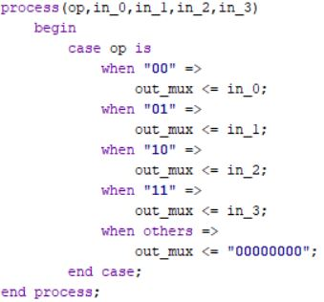
Muxes

Slide 24
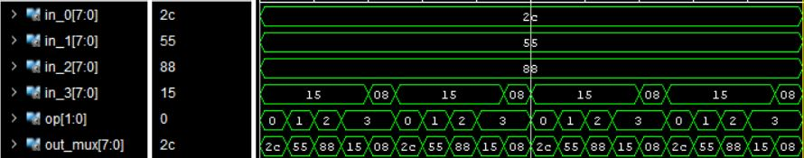
Mux Simulation

Slide 25
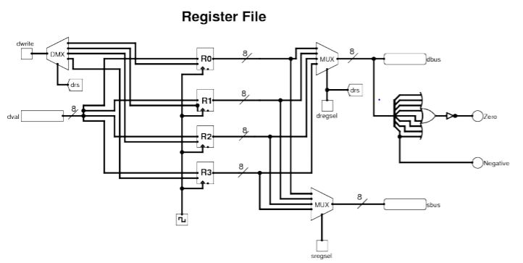
Register File

Slide 26
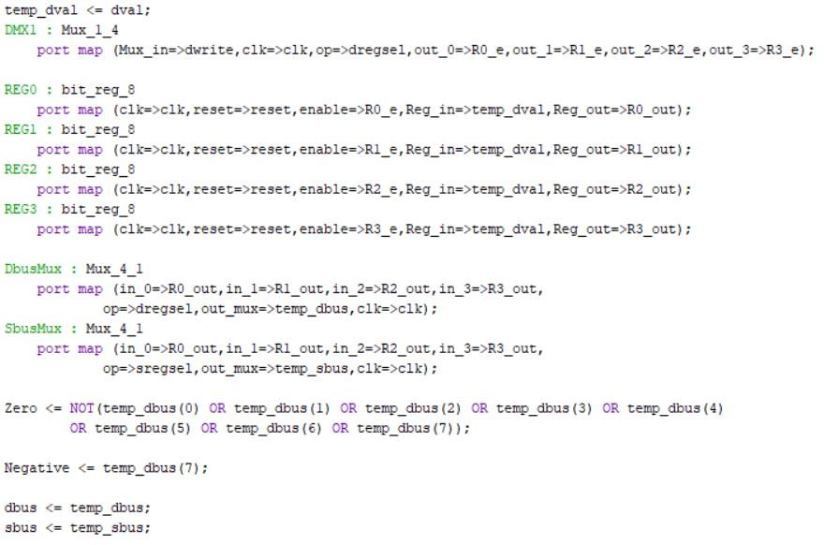
Register File Code

Slide 27
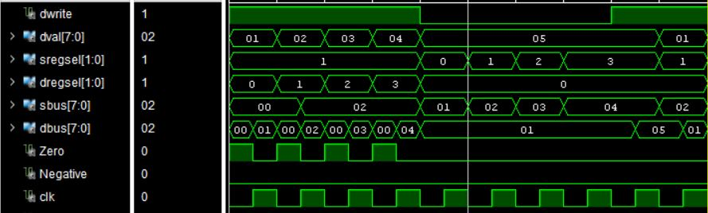
Register File Simulation

Slide 28
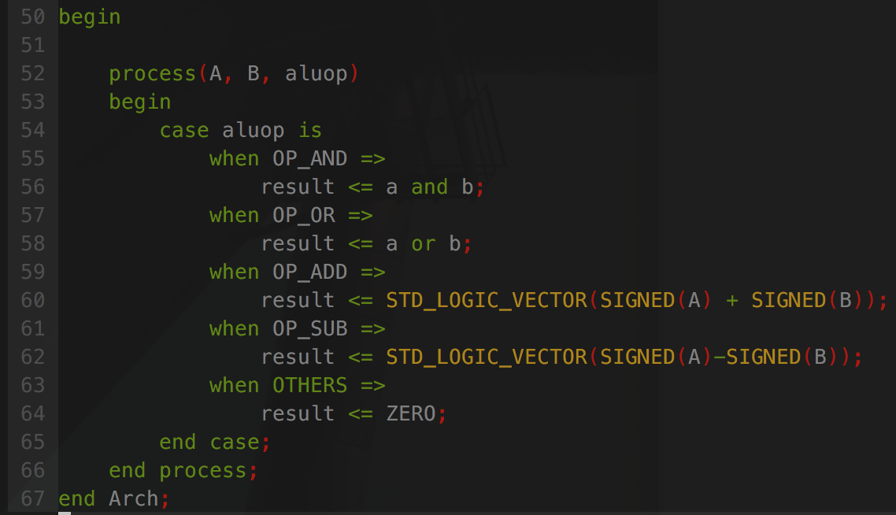
ALU
Taken from previous lab
4 operations

Slide 29
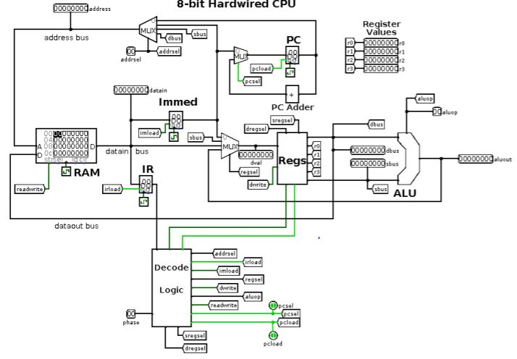
Connecting Components

Slide 30
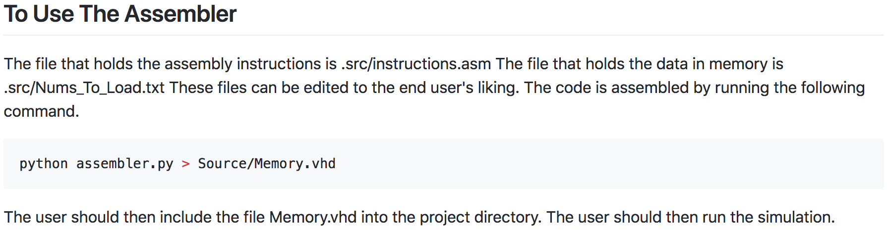
Assembler

Slide 31
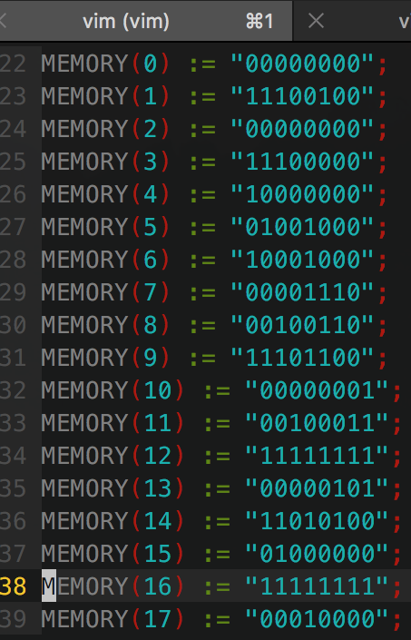
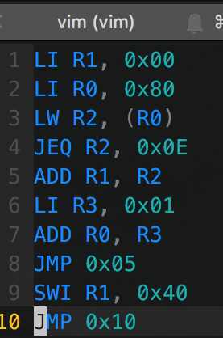
Assembler
Output
Input

Slide 32
Project
Source code for everything mentioned today is available at https://github.com/FueledbyJordan/VHDL_Microcontroller

